Slide 1


Slide 2
Student attendance system
Advantages of student attendance system
a Manage attendance of the students.
Add attendance via subject wise daily attendance or student daily attendance.
Mark the student present or absent
Manage student daily attendance or a specific school, class, and section.
Generate a report of the attendance which may be student daily attendance report or subject wise daily attendance report.

Slide 3
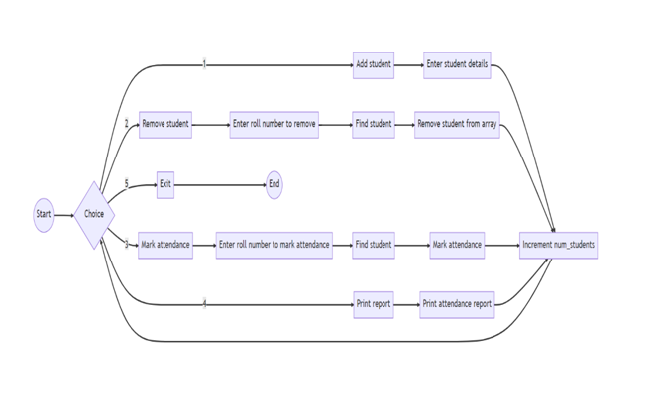
FLOW CHART

Slide 4
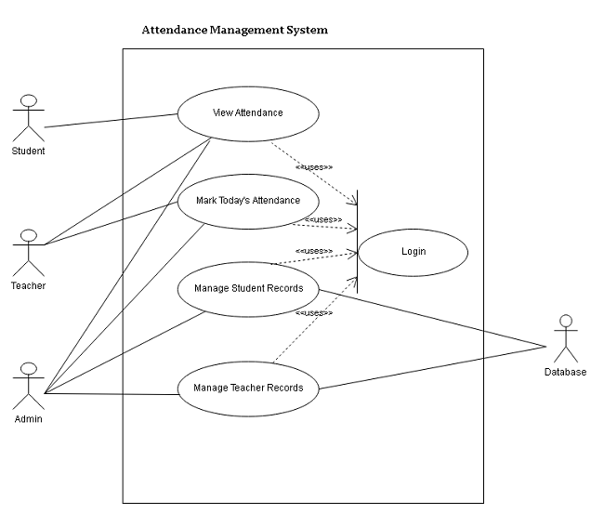
USE CASE DIGRAM

Slide 5
Conclusion
This whole work is to access the details about the student attendance information and generate a final reports.
This project provides an offer to the user to enter the data through their respective registration forms. It is very helpful for the teachers and admin to keep and maintain the information about the students easily.

Slide 6
Future Scope
The system can be further enhanced and several other functionalities can be added. The system can be made login independent. The present system logs in using Internet all the time. We can enhance the system by implementing offline mode login feature. The system can also be enhanced by using voice recognition feature of the Android. In future this work can be expanded to store the internal marks, semester marks, college events and college placements.

Slide 7


